Slide 1
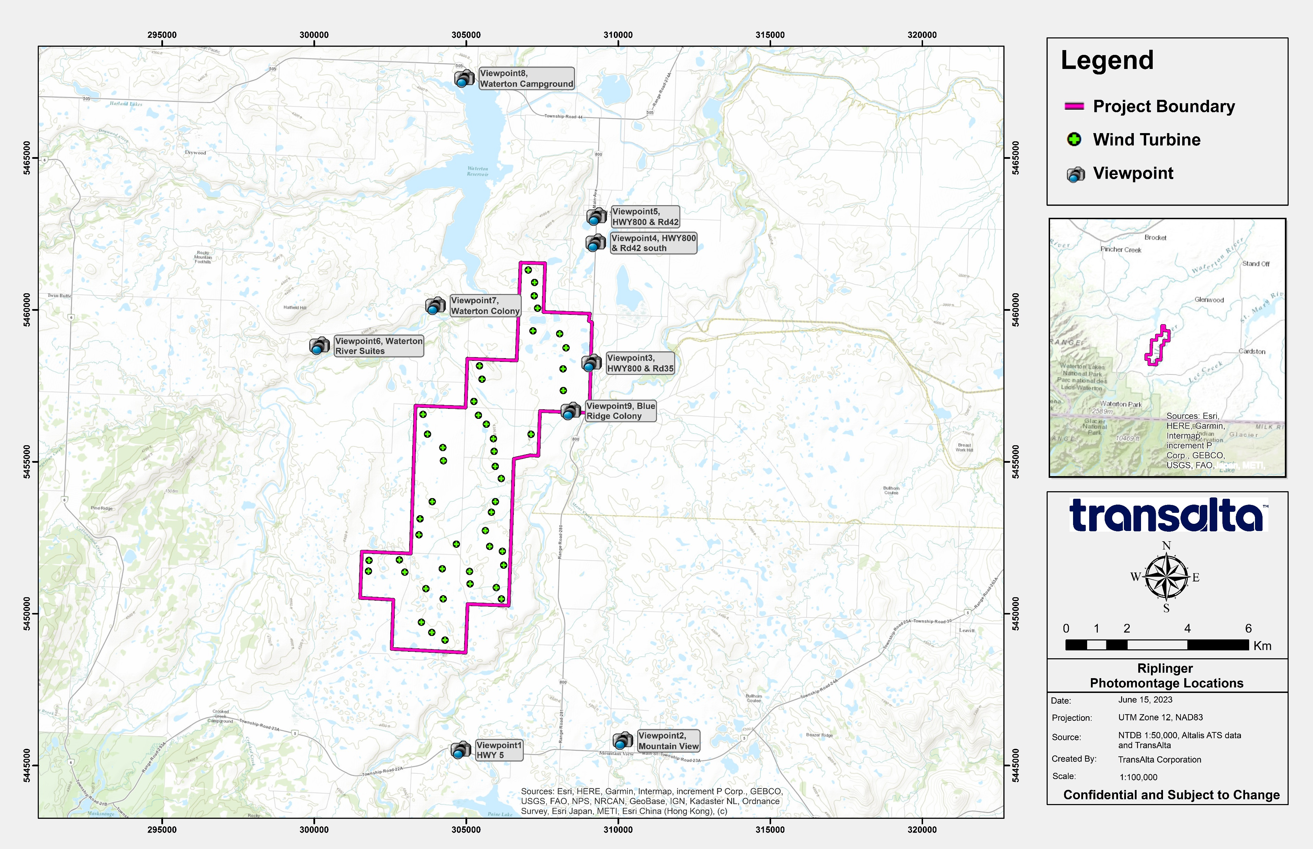

Slide 2
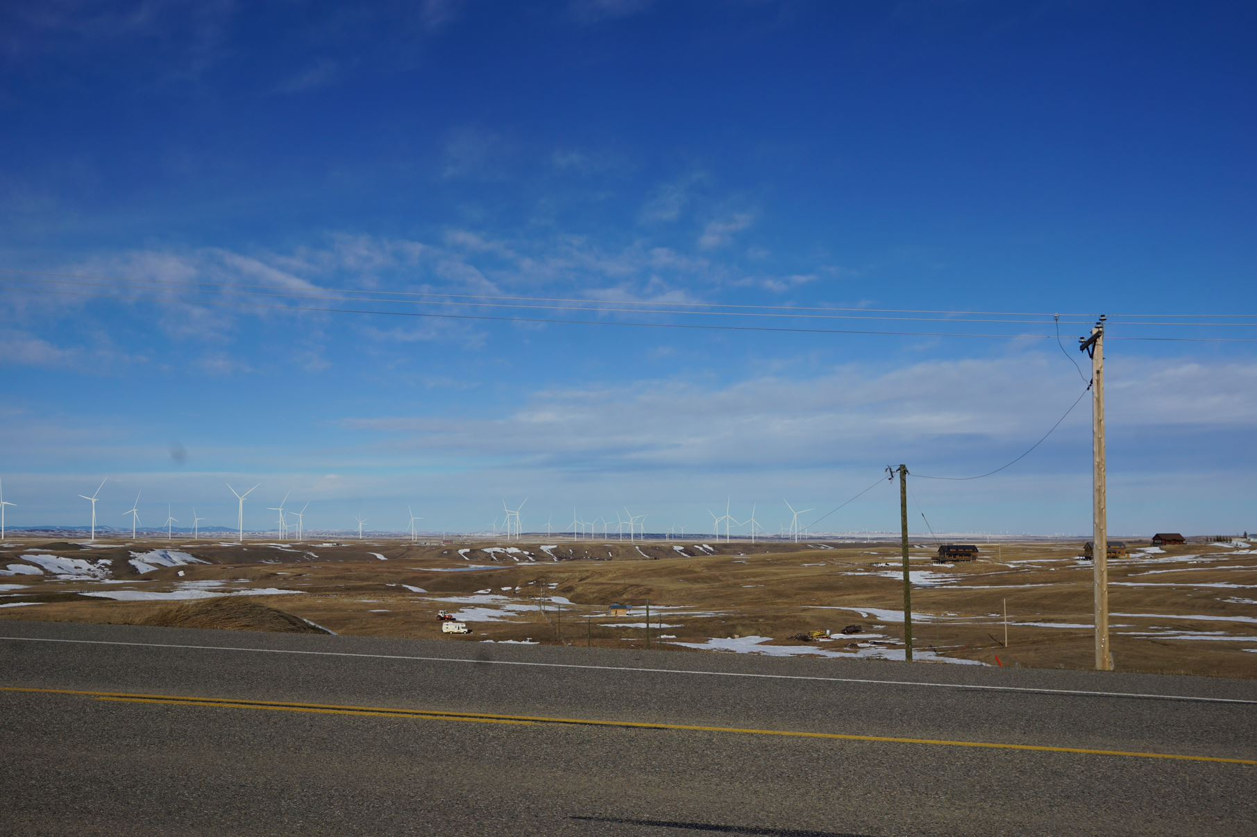
Viewpoint 1: Highway 5 looking North

Slide 4
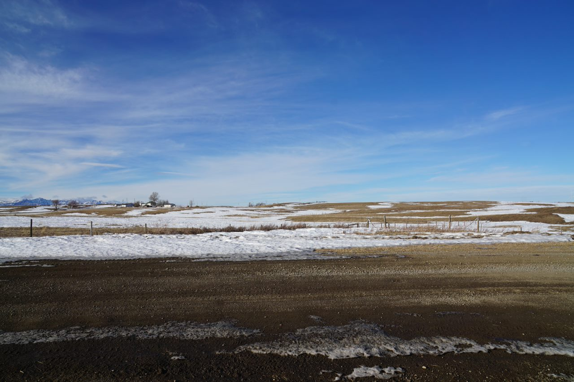
Viewpoint 2: Mountain View looking NorthWest

Slide 6
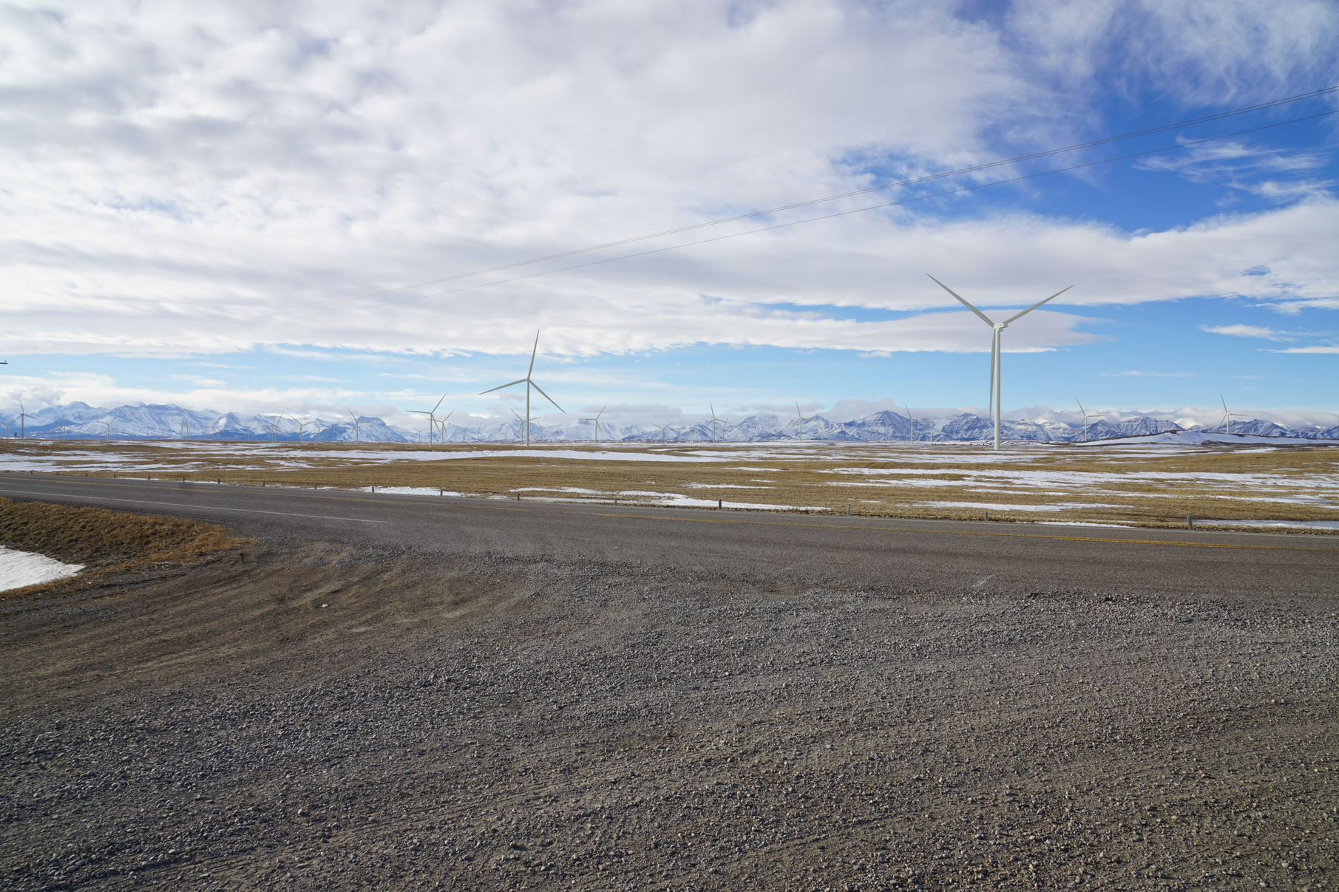
Viewpoint 3: Hwy800 & TR35 looking West (O-K Land & Cattle Sign)

Slide 7
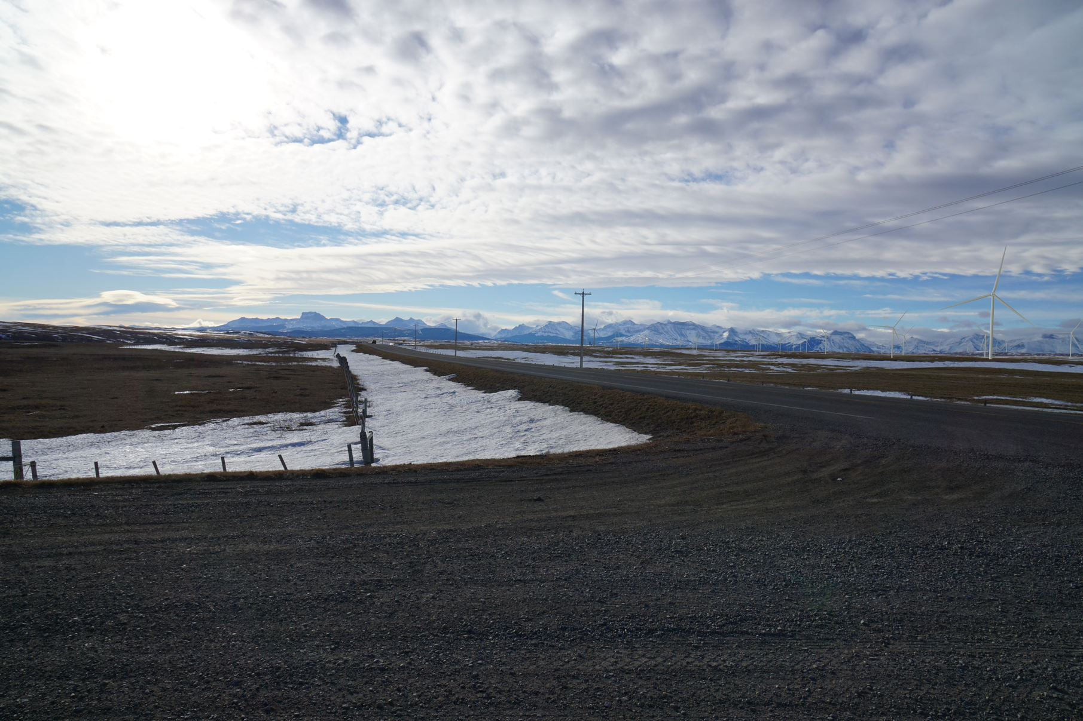
Viewpoint 3: Hwy800 & TR35 looking SouthWest (O-K Land & Cattle Sign)

Slide 9
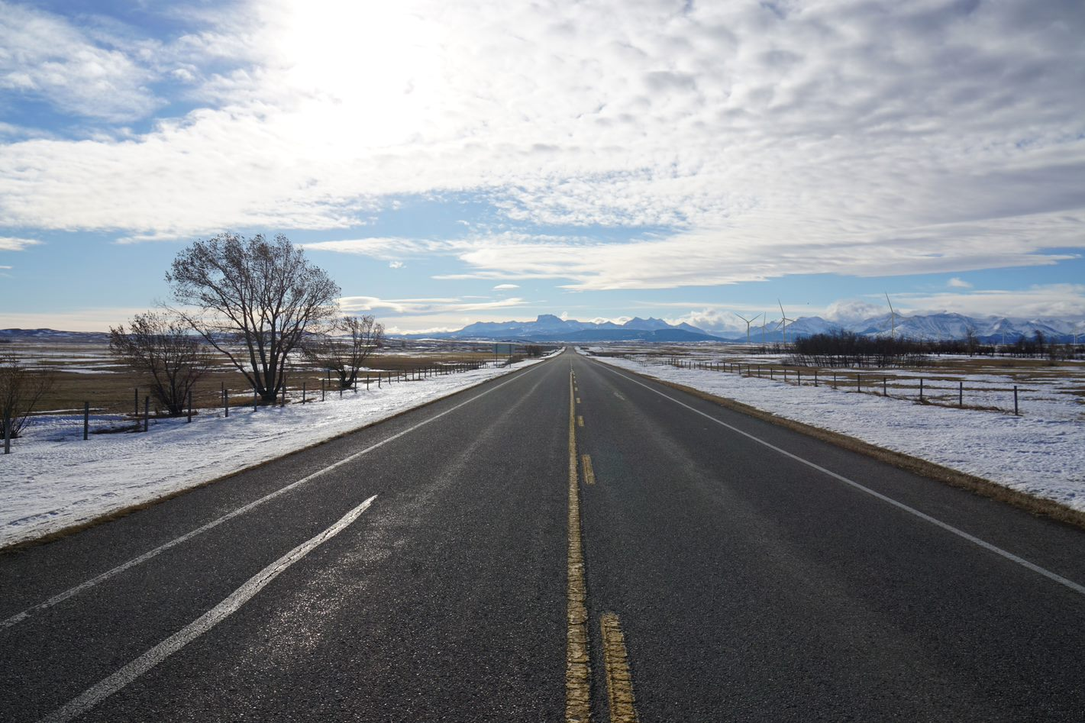
Viewpoint 4: Hwy800 & TR42 looking South (~1km South of Hill Spring)

Slide 11
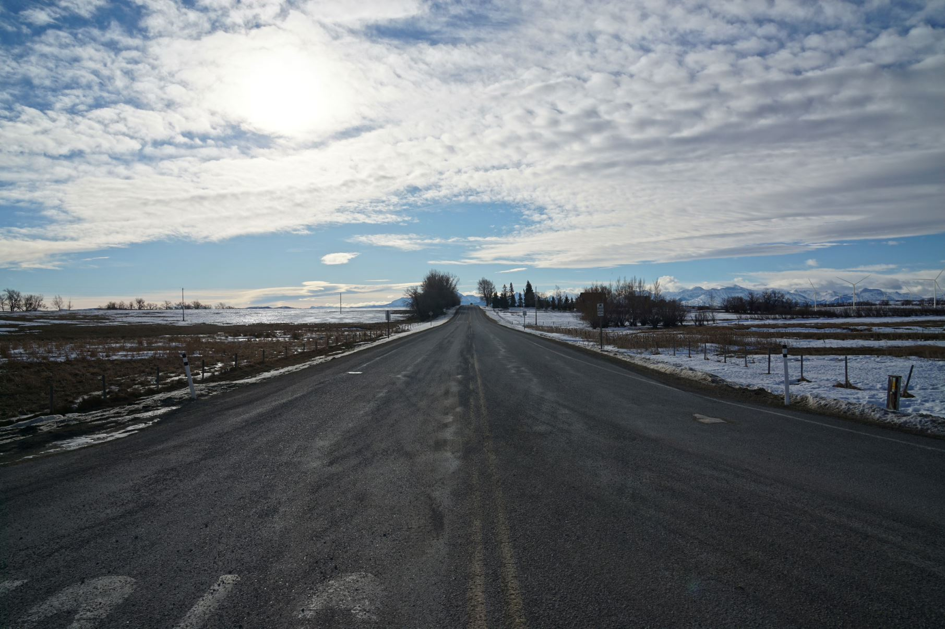
Viewpoint 5: Hill Spring looking South

Slide 13
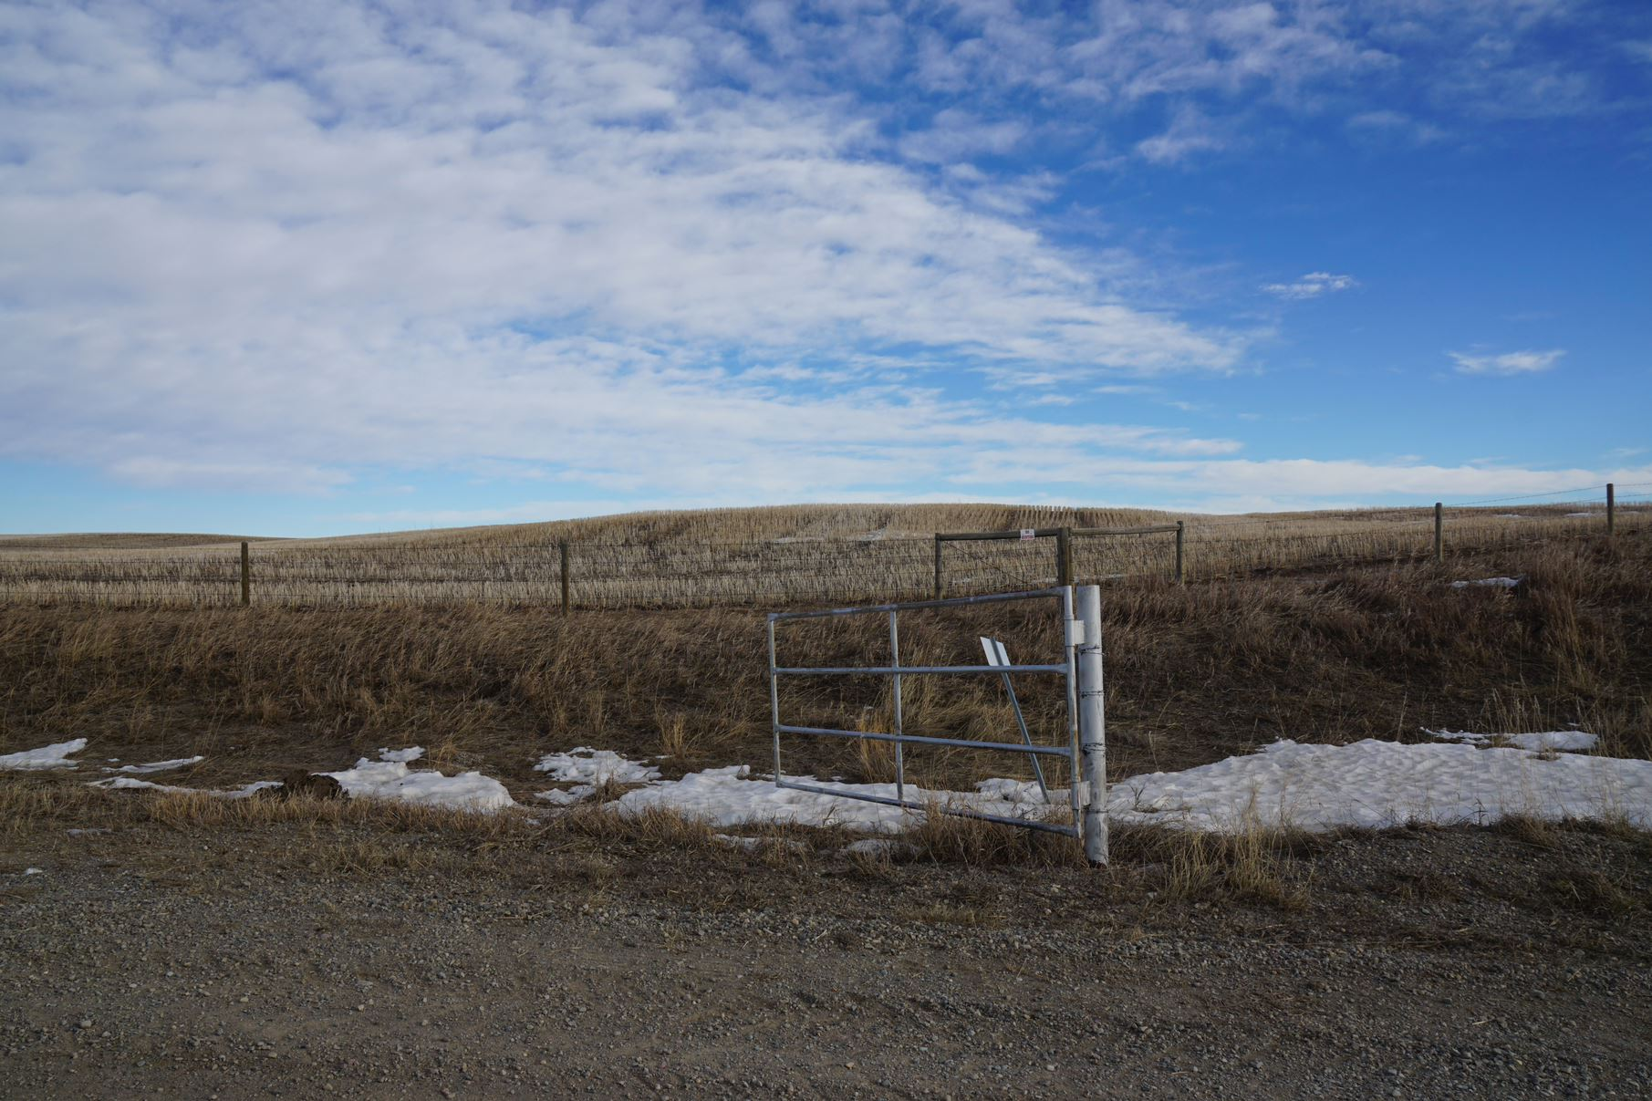
Viewpoint 6: Above Waterton River Suites looking West

Slide 14
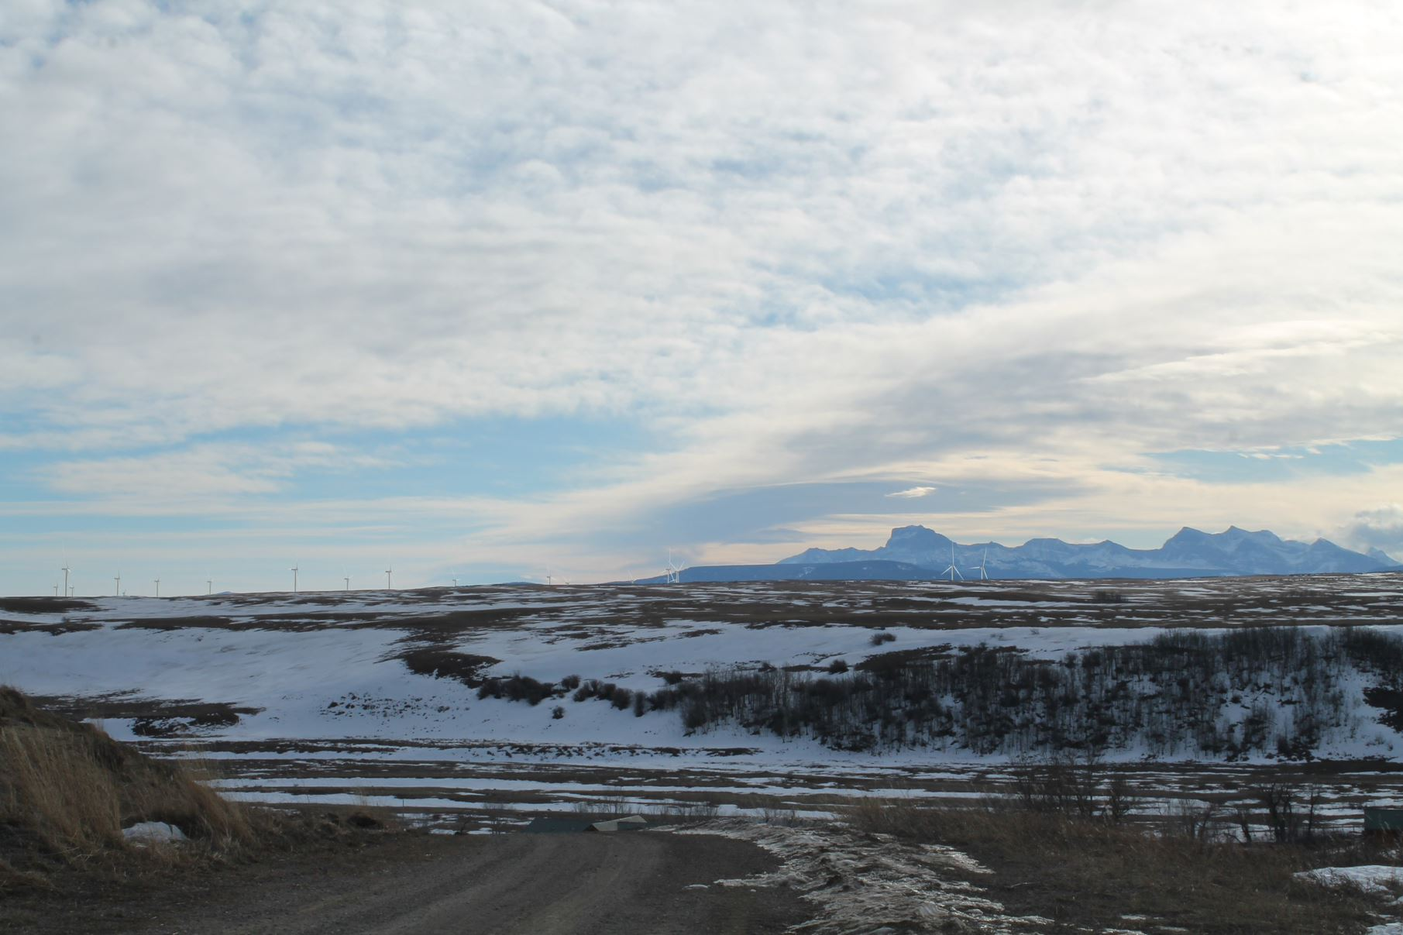
Viewpoint 6: Above Waterton River Suites looking South

Slide 16
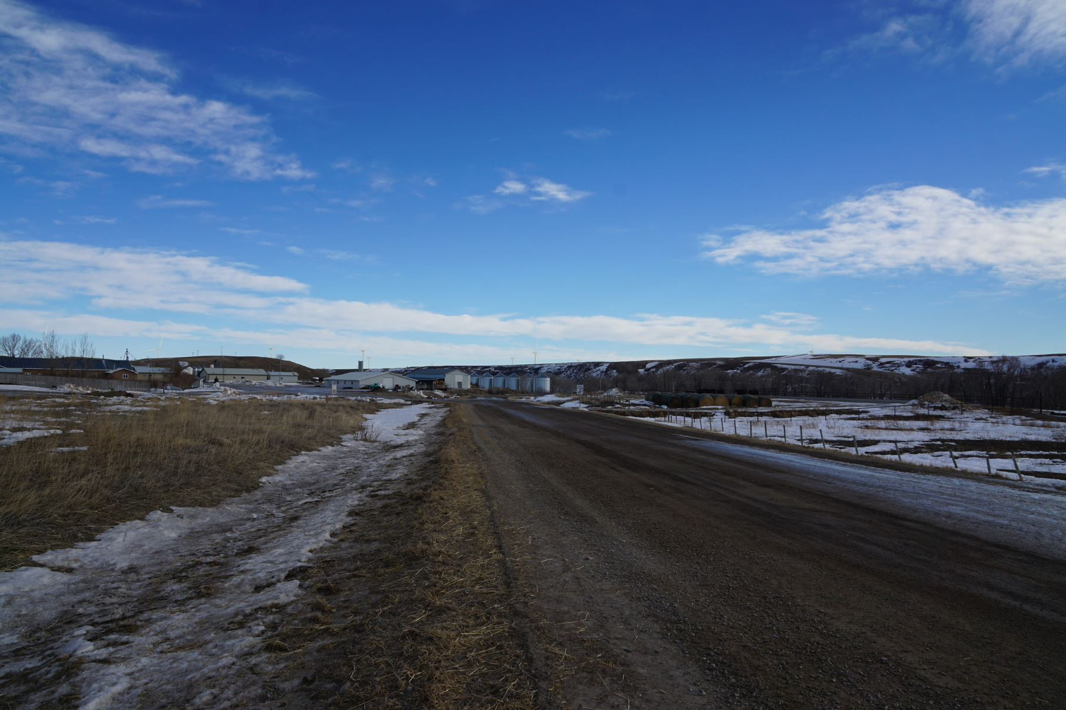
Viewpoint 7: Waterton Colony looking East

Slide 17
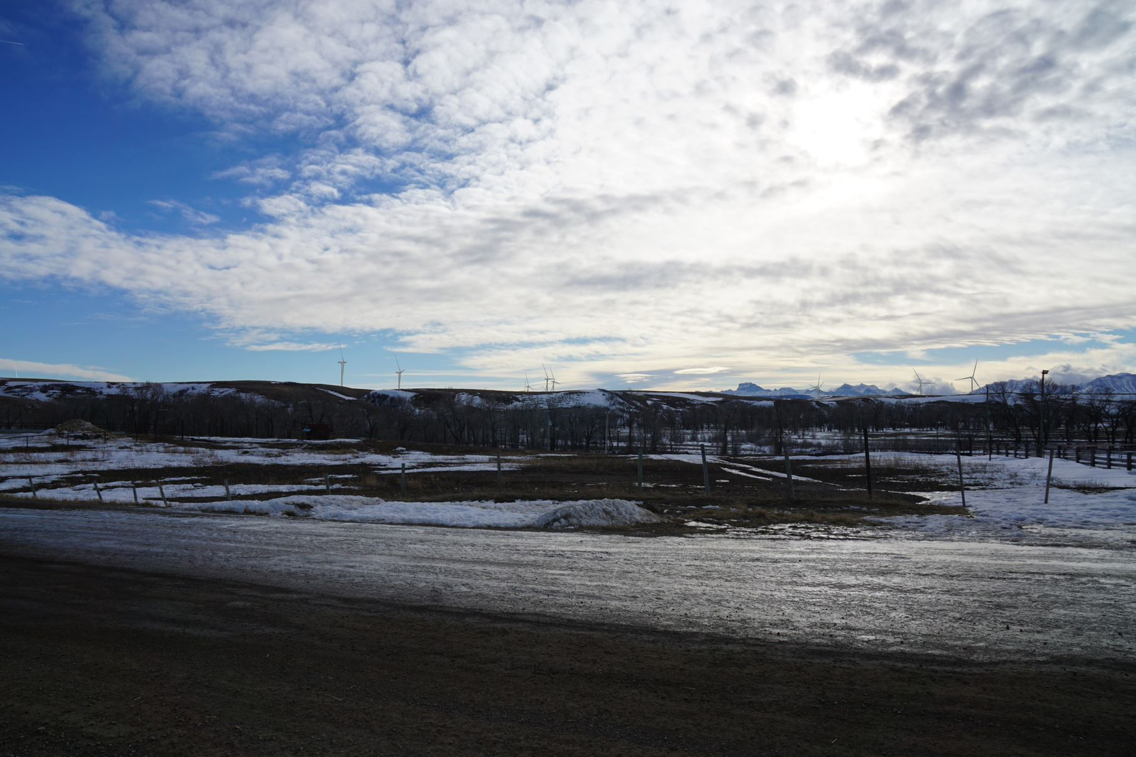
Viewpoint 7: Waterton Colony looking South

Slide 19
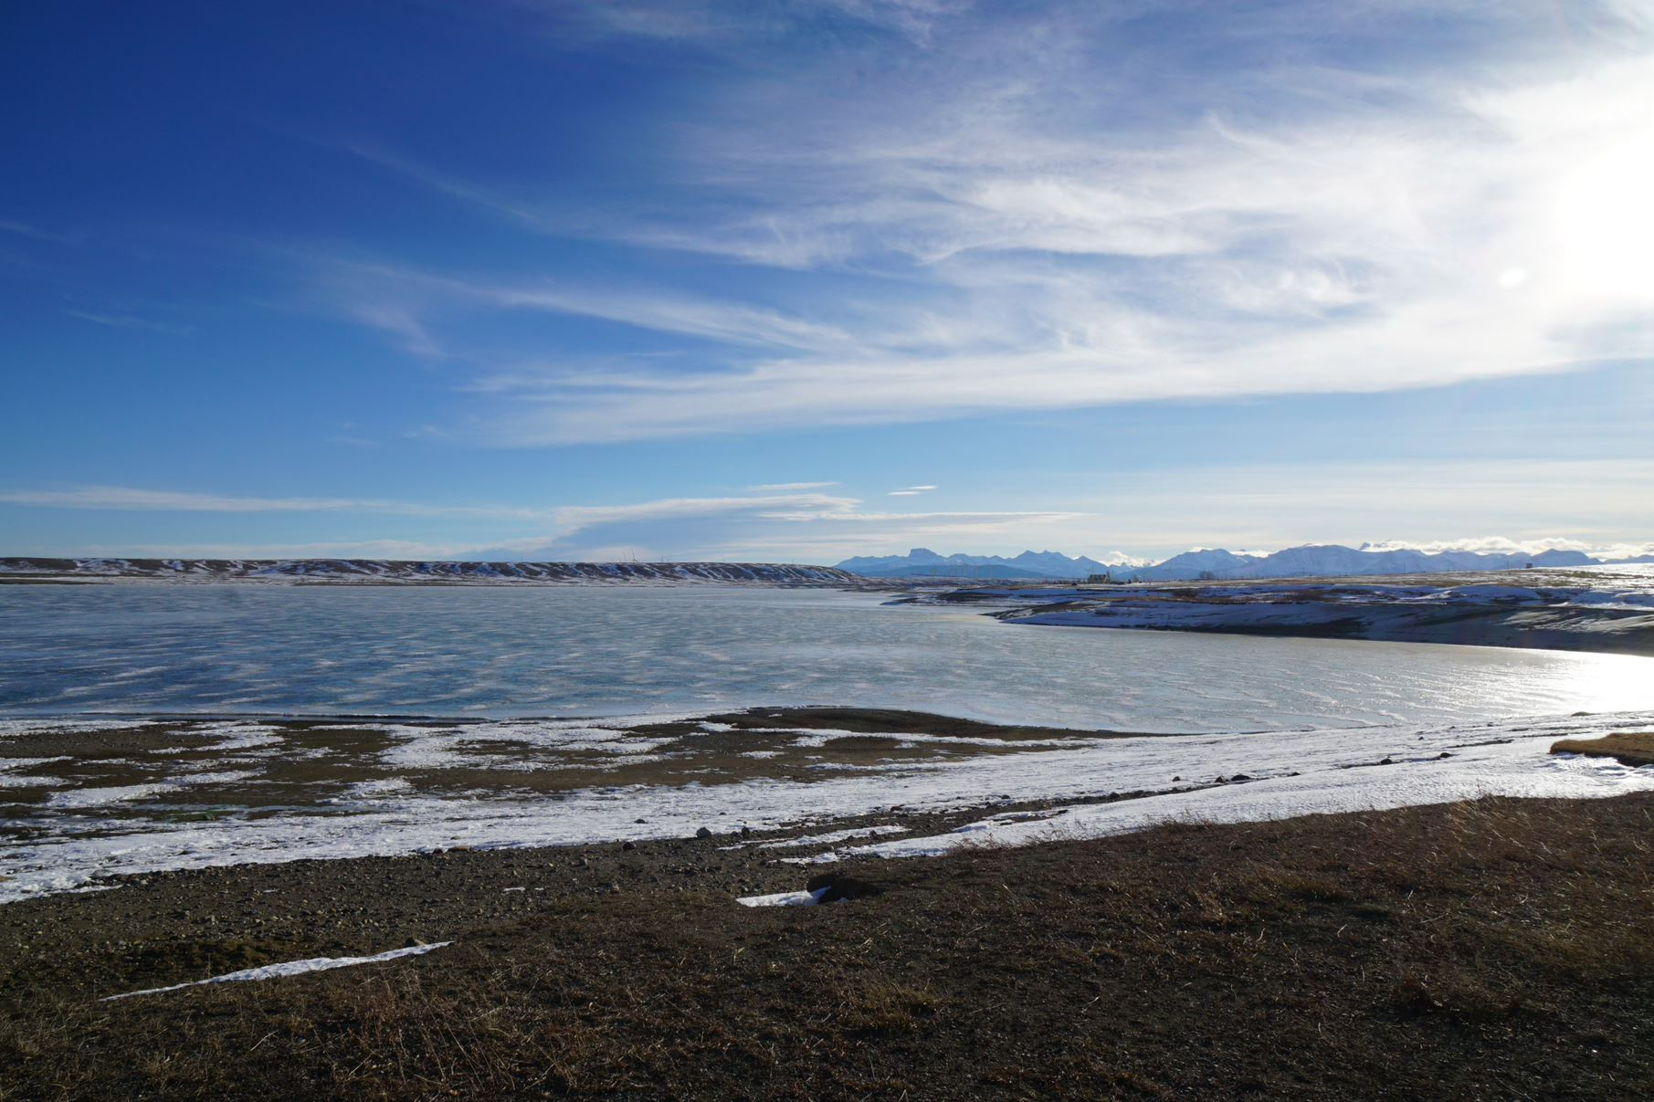
Viewpoint 8: Waterton Reservoir Campground

